Slide 1

Connecting the Fourier Series to the Discrete Fourier Transform
Karl Schleicher
March 10, 2018

Slide 2
Presentation Outline
You have previously
watched Khan Academy introduction lecture on the fourier series.
Watched youtube video “Introduction to the Fourier Transform.
Read the handwritten pdf I emailed to you titled “Connecting the discrete Fourier Transform to the Fourier Series”.
Review this material .
We will connect with Skype and I will talk you through the pdf.

Slide 3
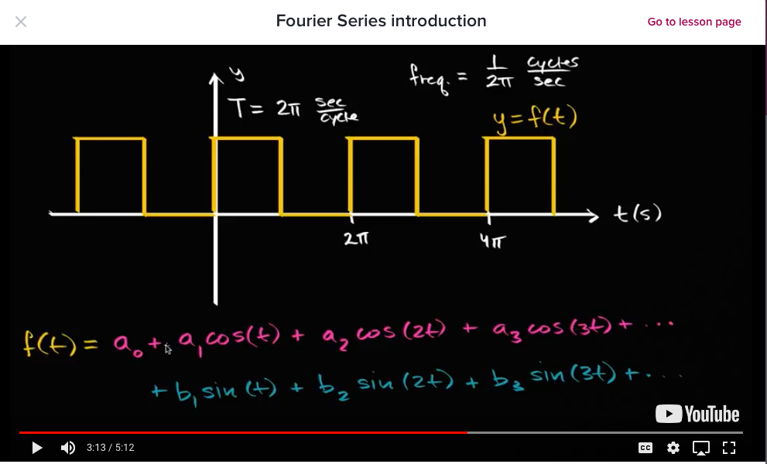
https://www.khanacademy.org/science/electrical-engineering/ee-signals/modal/v/ee-fourier-series-intro

Slide 4
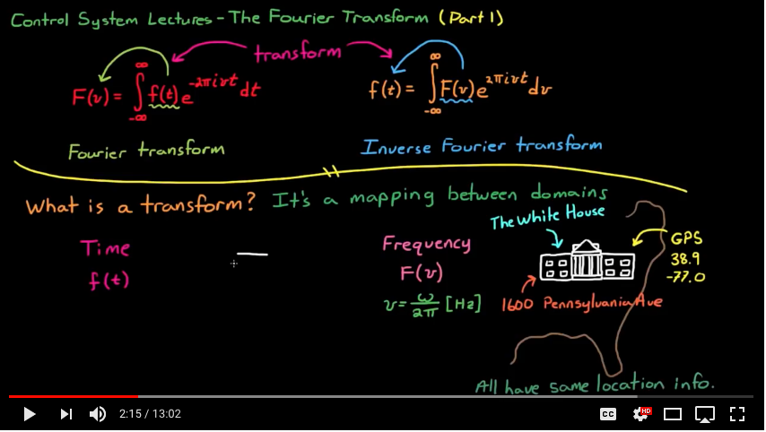
https://www.youtube.com/watch?v=1JnayXHhjlg

Slide 5
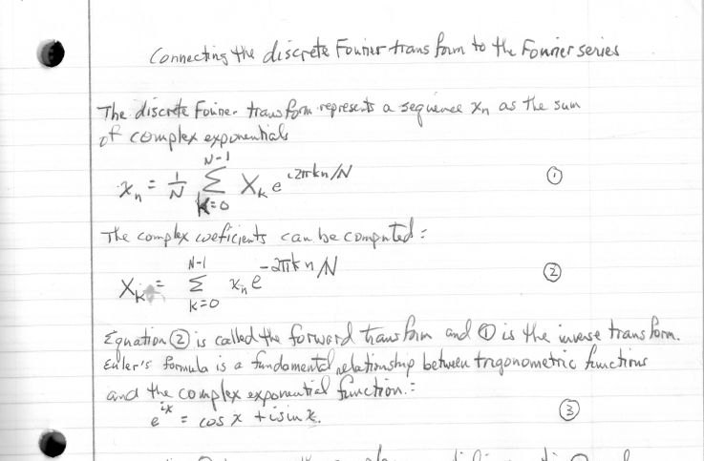
PDF from email

